Slide 1
Lesson: Data Types and Return Types

Slide 2
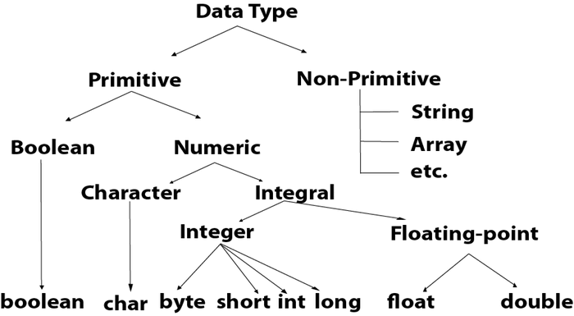
Data Types:
Data types specify the different sizes and values that can be stored in the variable.
There are two types of data types in Java:

Slide 3
Primitive Data Types:
Complier:
A program that converts instructions into a machine code form so that they can be read and executed by a computer.
Data Types | Size | Wrapper Class | Default Value
byte | 1 | Byte | 0
short | 2 | Short | 0
int | 4 | Integer | 0
long | 8 | Long | 0
float | 4 | Float | 0.0
double | 8 | Double | 0.0
boolean | - | Boolean | false
char | - | Character | -
String | - | String | null

Slide 4
Primitive Data Types
Byte: To find range: Formula
-2^n-1 to +2^n-1
For byte…..
1 byte =8 bits
So n=8
-128 to +127
Short:
-It has a range of values from -32,768 to 32,767.
-Its default value is 0.
Int:
-It has a range of values from -2,147,483,648 to 2,147,483,647.
-Its default value is 0.
Long:
-The long data type is commonly used in applications where large integer values are required
-long n = 2000000l ( enter to enter l finally)

Slide 5
Primitive Data Types
Float:
-It can represent a wide range of decimal values
-float f= 10.06f
Double:
-It provides a wider range of values and greater precision compared to the float data type -Its default value is 0.0d. ( No need to enter d )
Char:
-Character is any number, any alphabet or any special character
-char = ‘A’ →single quotation
Boolean:
- boolean data type represents a single bit of information with two possible states: true or false.
-boolean b1=true;
-boolean b2=false

Slide 6
Non –Primitive Data Types
These are user-defined data types created by programmers.
The default value of any reference variable is null.
These types reference objects or instances, and they don't have fixed sizes.
Whenever we are passing a non-primitive data type to a method, we are passing the address of that object where the data is stored.
There are five types of non-primitive data types in Java. They are as follows:
1. Class
2.Object
3.String
4.Array
5.Interface
Parent class

Slide 7
Continue….
Class and Object:
Classes define the structure and behavior of objects.
String:
A sequence of characters
Array:
Used to store multiple values of the same type.
Interfaces:
Abstract types used to specify a behavior that classes must implement.
Parent class

Slide 8
Return Types
Void:
-The void return type doesn't require any return statement.
-If we try to return a value from a void method, the compiler shows an error.
Return Statement:
-It is used for returning a value when the execution of the block is completed.
-Syntax: return returnvalue;
-The return type of the method and type of data returned at the end of the method should be same type.
- The variable that stores the returned value after the method is called should be a similar data type.
-If a method is declared with parameters, the sequence of the parameter must be the same
Parent class

Slide 9
Wrapper Class
The wrapper class in Java provides the mechanism to convert primitive into object and object into primitive.
It is used to convert any data type into object
Class of data type is called wrapper class
All classes and wrapper classes default value is Null.
Use of Wrapper classes in Java
Change the value in Method
Serialization
Synchronization
java.util package
Collection Framework
Parent class

Slide 10
Thank You!! We will Continue with Polymorphism

